Slide 1

GOING VIRAL
TEAM 10
Emily Chen, Allison Higgins, Lina Huang, & Chloé le Comte
chenem@, ahigg@, hlina@, chloeml@seas.upenn.edu
◆◆◆
Advisor: Dr. Pappas
Email: pappasg@seas.upenn.edu
Notes:
Emily

Slide 2



Purpose of the Project
INTRODUCTION
2
Problem Identification
Resource Allocation
Planning Policy Tool
Epidemic outbreaks are a major concern to public health and a strain on resources
Efficient resource allocation saves money and curbs the spread of diseases
Create a resource allocation policy planning tool represented on a web interface
Notes:
Talk about timeliness (epidemics like zika and ebola + lots of large data sets now available) and who the users are
Emily
Viruses as problem identification (ebola in 2014)
Resource allocation
Create a policy tool for public health officials. These tools are especially relevant when you have large data sets to analyze and visualize

Slide 3
Yearlong Milestones
4
MILESTONES
3
MILESTONES
Yearlong Milestones
 | SEPT | OCT | NOV | DEC | JAN | FEB | MAR | APR
Finding project idea
Research & goal-setting
Obtaining & cleaning data
Creating web data visuals
Decipher MATLAB code
Integrate MATLAB to web
Making website dynamic
Fine-tuning math model
Updating website design
Collecting user feedback
Integrating user feedback
Testing final product
Notes:
Emily

Slide 4
Disease Spread through a Network
MODEL
4
Weighted, directed network graph
SIS Epidemic Model
β_{ij}
S
I
δ_{i}
Probability of disease spreading depends on how infected the city’s set of neighbors are, as well as the recovery rates and the proportions of each city currently infected
Notes:
Allison
Be careful of using ‘terminology” that new people won’t understand

Slide 5
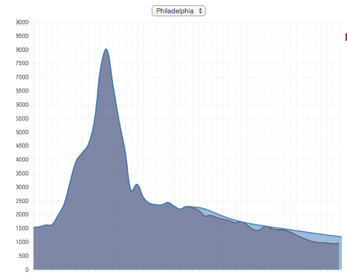
Calibrating the Predictive Model
MODEL
5
Prediction Model:
p₁(t+1)
p₂(t+1)
…
…
p_{n}(t+1)
δ₁ | b₁₂ | … | … | b_{1n}
b₂₁ | δ₂ | b₂₃ | … | …
b₃₁ | b₃₁ | δ₃ | … | …
… | … | … | … | b_{n-1,n}
b_{n1} | … | … | b_{n,n-1} | δ_{n}
p₁(t)
p₂(t)
…
…
p_{n}(t)
=
Matrix Formulation:
Solving for Natural Recovery Rates:
1
Initialize a possible set of δ_{i} values
Calculate absolute difference between real & estimated data across all cities and years
Repeat steps 1 & 2 for all combinations of δ_{i}
Return set of δ_{i} values with minimum difference
2
3
4
Notes:
Allison
We came up with this algorithm, and coded it
We started with a simplification that we were given, we chose to make it more accurate

Slide 6
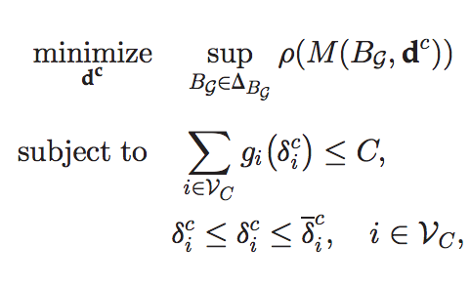
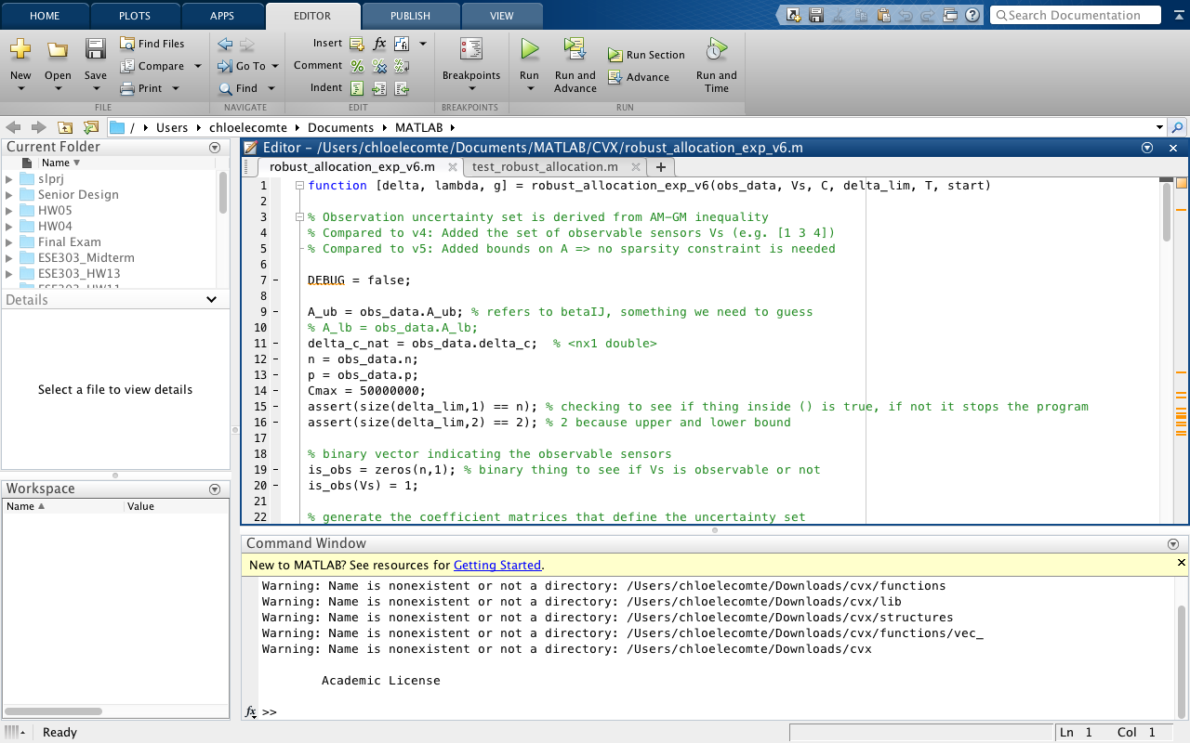
Resource Allocation Model
MODEL
6
Convex Optimization Problem
Local min is global min
Scalable for large data sets
Faster algorithm
Implemented using CVX MATLAB Library
Results
Optimal budget allocation
Improved recovery rates
Cost per infection prevented
Graph of projected improvements
Notes:
Lina
DON’T TALK ABOUT…
Faster algorithm
Cost per infection prevented
Or graph of projected improvemtns

Slide 7
Software Architecture
PLANNING TOOL
7
Iteration 1 | Iteration 2 | Iteration 3 | Iteration 4 | Iteration 5 | Iteration 6
CVXOpt and CVXPy | Python MATLAB Engine | Heroku Deployment | SEAS Server with PHP | Digital Ocean: Ubuntu Servers | Deployment & Redirecting to Domain
User
Budget, year, network
Website
HTML, CSS, Javascript
Python
Flask web framework
MATLAB
CVX Package
Results Table &
Graphical Impact of Allocation
Cost Allocation &
Improved Recovery Rates
Notes:
Lina

Slide 8
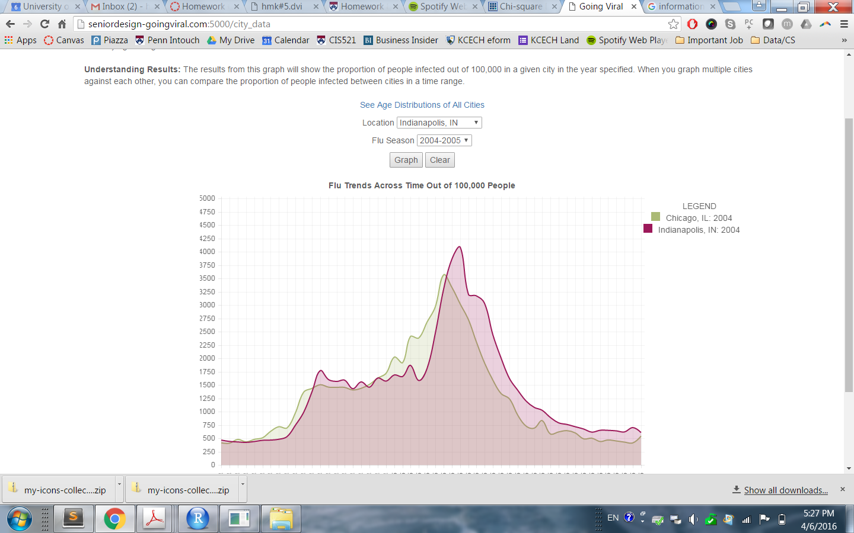
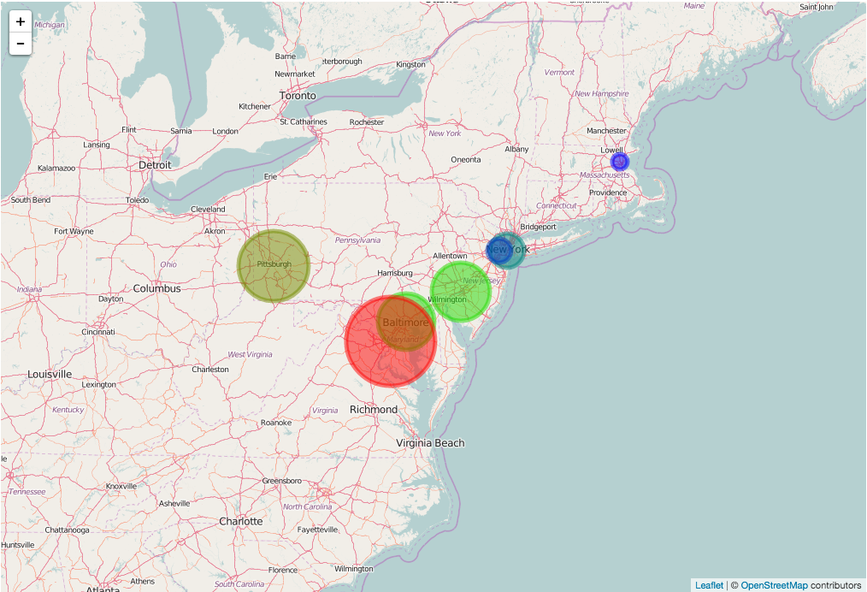
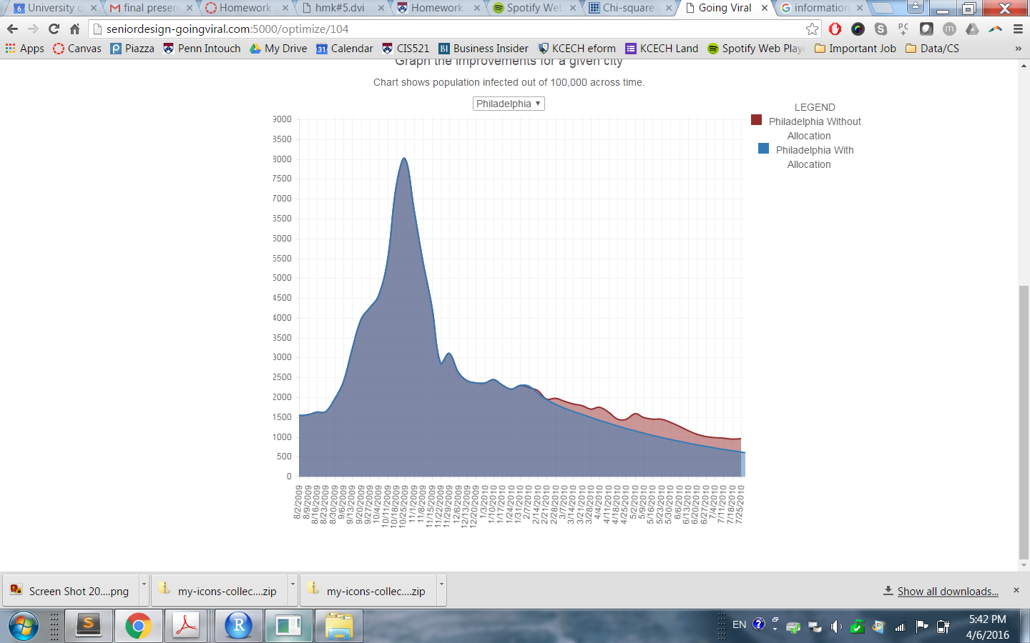



Planning Tool Features
PLANNING TOOL
8
Flu Data by City
Graph number of infected people out of 100,000 by flu season and city. Users can interactively graph cities and years simultaneously, as well as view age distributions of populations.
Heat Map
Choose a network of cities and a time period to map. The model calculates which cities’ data in that particular network is most correlated with others’.
Resource Allocation
Input budget, year, and network for an outputted graph and table of cost allocations, improved recovery rates, people saved, and cost per life saved for each city.
Notes:
Chloé

Slide 9
User Feedback
PLANNING TOOL
9
 | Sarah Jenkins & Megan Doherty Create results table in Resource Allocation Add age distribution for comparison Rename “Influential Cities” page to “Heat Map”
Heather Klusaritz Add explanatory info on each page Include “How to Interpret Results” Graph flu seasons instead of years Make Heat Map more intuitive
Notes:
http://seniordesign-goingviral.com:5000/
Chloé
Talked to several health professionals

